Slide 1
A Project on Exam Cell Automation System
By:
Manav Aggarwal ( 2001320139004 )
Ankit ( 2001320139002 )
Afzal ( 2001320139001 )

Slide 2
INTRODUCTION
Like every management system, it is developed to reduce manual effort.
It is a simple, easy way to use web-based centralized user interface system that is used for storing, retrieving, managing and aggregating examination objects.
It will help to automate the complete lifecycle of examination of the university.

Slide 3
MOTIVATION
The earlier techniques required more manual effort.
More time was consumed for the pre-exam and post-exam preparations.
Hectic and complex procedures for both faculties and students.

Slide 4
OBJECTIVE
We aim at building a web based application that can be operated by the authorities of the departments and accessed by the students.
Since the examination tenure is short but complex, it aims at reducing the time for every step.
It will provide compactness, better data accessibility and less effort.

Slide 5
LITERATURE SURVEY
The orthodox way of examination procedure used to be offline and manual including lot of paper work.
This procedure has lots of steps and stages, hence a few systems have been already developed around the globe.
In universities like ours, having semi-automated system, half of the work is either done manually or they have different scattered management systems.

Slide 6
PROPOSED METHODOLOGY
Creating separate login for each department and students.
They will see the sections of work of their respective duties.
They will be interlinked.
All the activities will be done under the supervision of authorities.

Slide 7
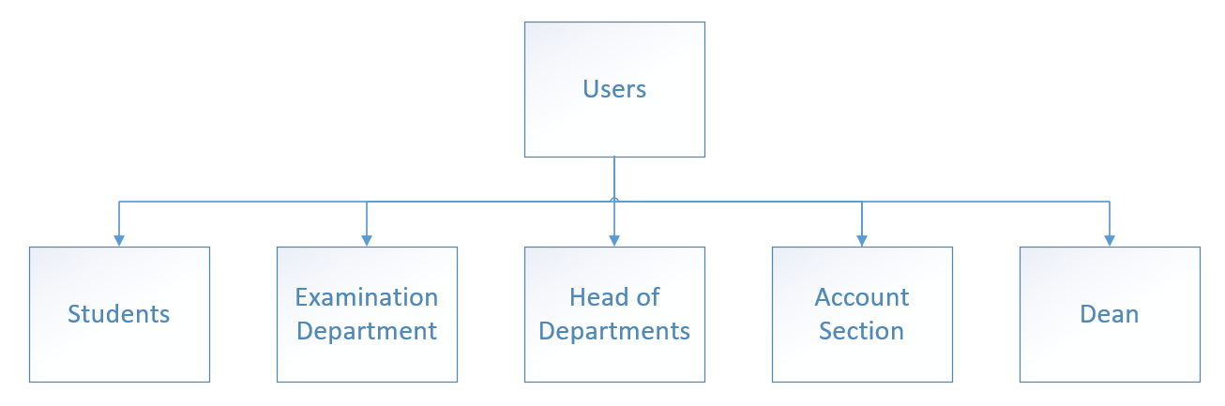
Users that are usually incorporated with the examination procedures.

Slide 8
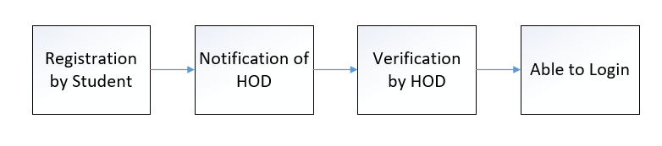
Example of Interlinked Procedures

Slide 9
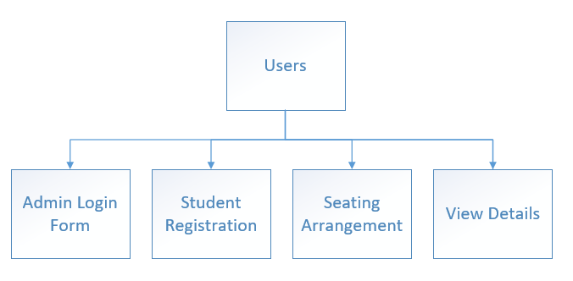
Modules to be included for User

Slide 10
Technology to be Used
Visual Studio .Net
Visual Studio .NET is Microsoft’s visual programming environment for creating web services based on the use of Extensible Mark Up Language(XML).The product suite provides a visual interface for identifying a program as a web service, forms for building a user interface(including support for mobile device interfaces),features for integrating existing application data, and for debugging.
Microsoft SQL Server Express
Microsoft SQL Server Express, a freely downloadable and distributable version of Microsoft's SQL Server relational database management system, comprises a database specifically targeted for embedded and smaller-scale applications.

Slide 11
EXPECTED OUTCOME
By the end of the major project, we aim at completing two modules, i.e. registration procedures and exam form filling.
By the end of the complete project we would be able to reduce the complexity of the procedures and the hustle on the exam day.
It will provide compactness, better data accessibility and less effort.

Slide 12
CONCLUSION
A web based interface for showing hall name for student is developed, which makes students to see their seat in respective hall easily. Username and password is created for unique user by registering their details in register module.

Slide 13
REFERENCES
www.dotnet-tutorial.com
www.worldcolleges.info
www.dotnetspider.com/tutorials/DotNet-Tutorials.aspx
https://en.wikipedia.org/wiki/.NET_Framework

Slide 14
THANK YOU.

